Slide 1
AI Vs Human text Classification
Term Project Presentation - Group 6
Team members:
Deivanai Thiyagarajan
Ramya Lakshmi Kuppa Sundararajan
Yoonki Lee

Slide 2
Project Overview
Objective: Distinguish between AI and human-generated text.
Dataset: 500,000 paragraphs.
Methods: Data preprocessing, feature extraction, and model evaluation, Visualization, HyperParameter Tuning.
Tools: Python, Pandas, NLTK, Scikit-Learn, Matplotlib.

Slide 3
Data cleaning and preprocessing
Key Steps:
Data balancing: Ensuring equal representation of both classes.
Text preprocessing:
Tokenization
Stopword removal
Lowercasing
Punctuation and word count analysis
Code Snippets:
data['text'] = data['text'].apply(lower_case)
data['tokens'] = data['text'].apply(tokenize)

Slide 4
Feature Engineering
Techniques:
Average sentence length calculation
Punctuation Count
Word Count
TF-IDF and CountVectorizer (Bag of Words)

Slide 5
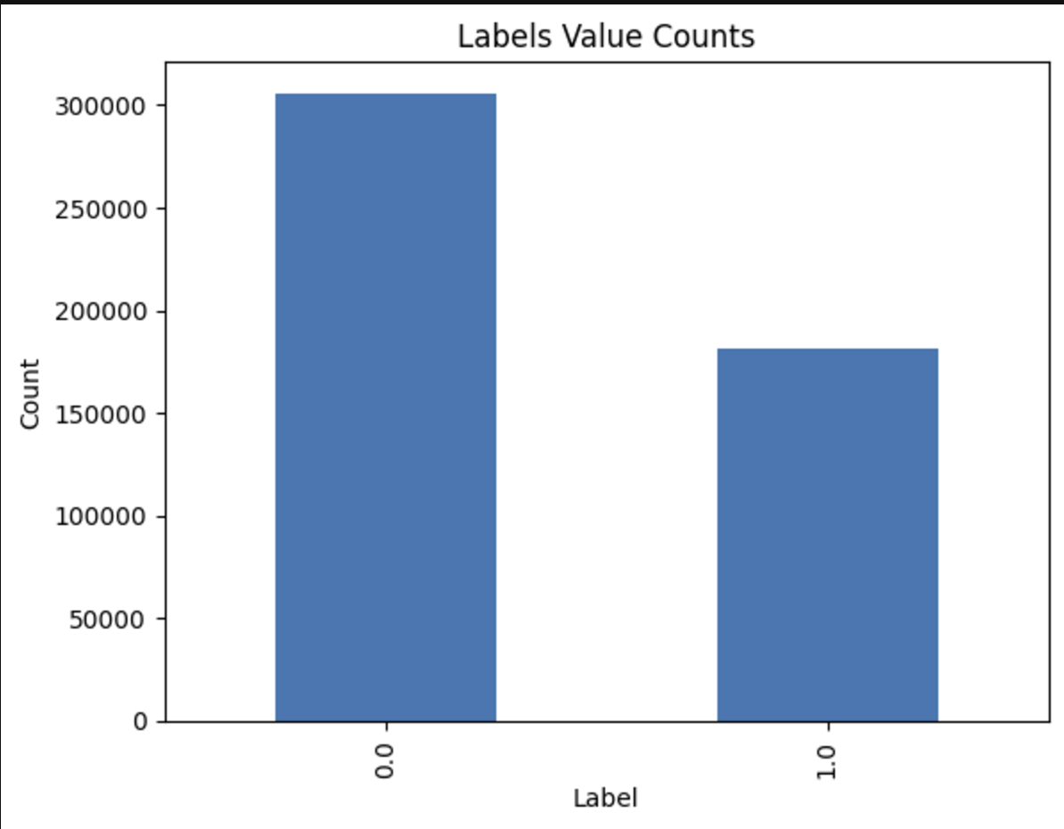
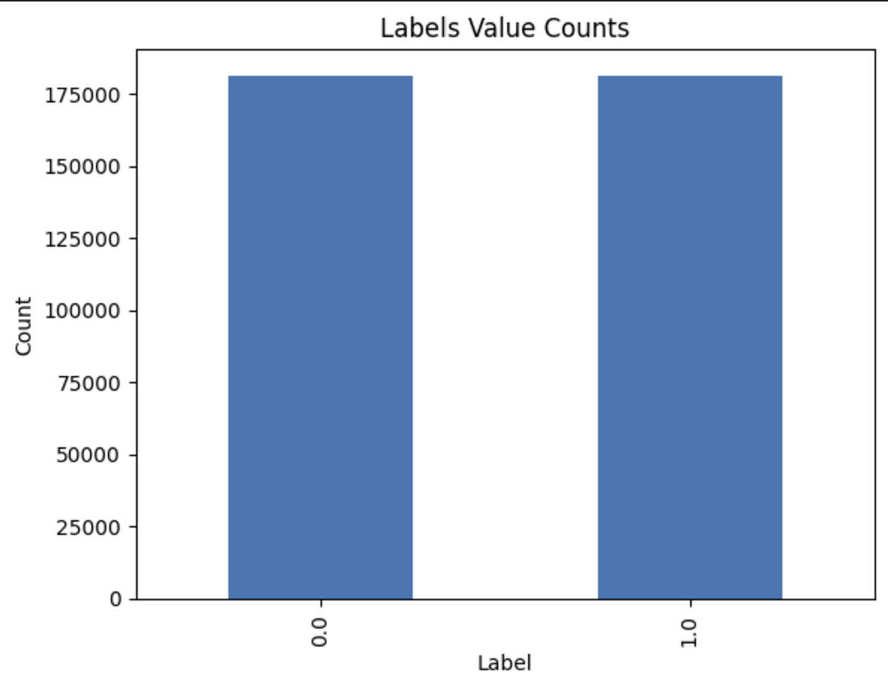
Visualizations
Before and After Balancing the Classes

Slide 6
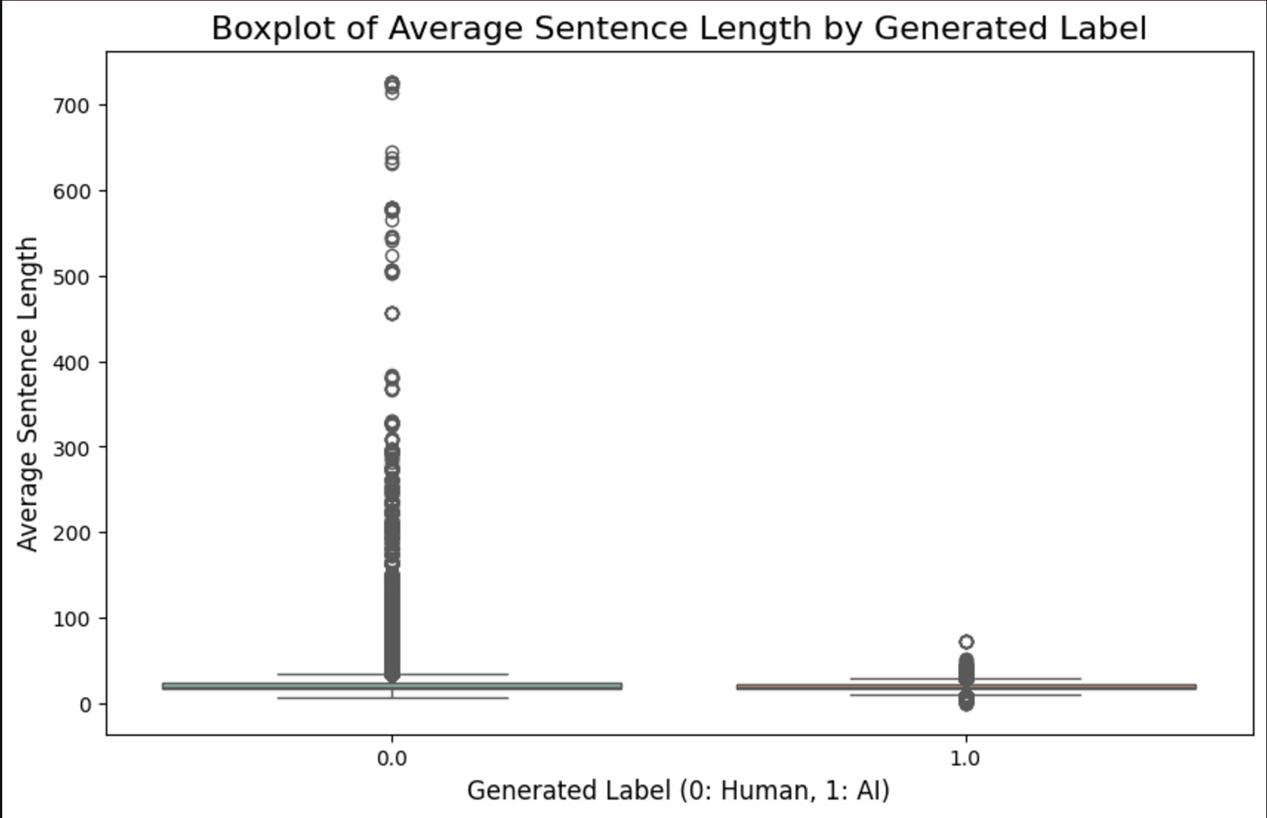
Distribution of Average Sentence Length

Slide 7
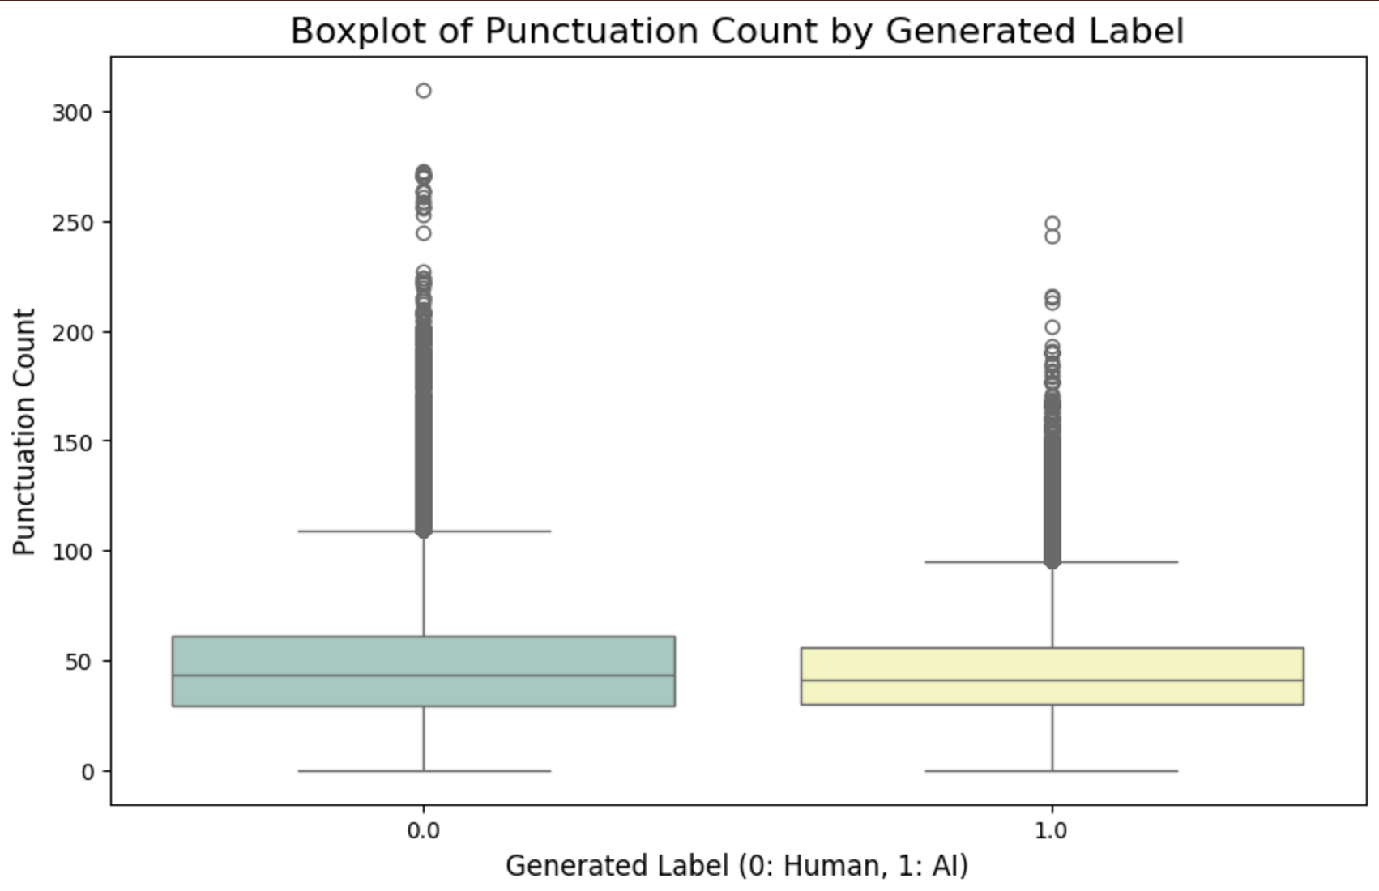
AI Vs Human Punctuation Count

Slide 8
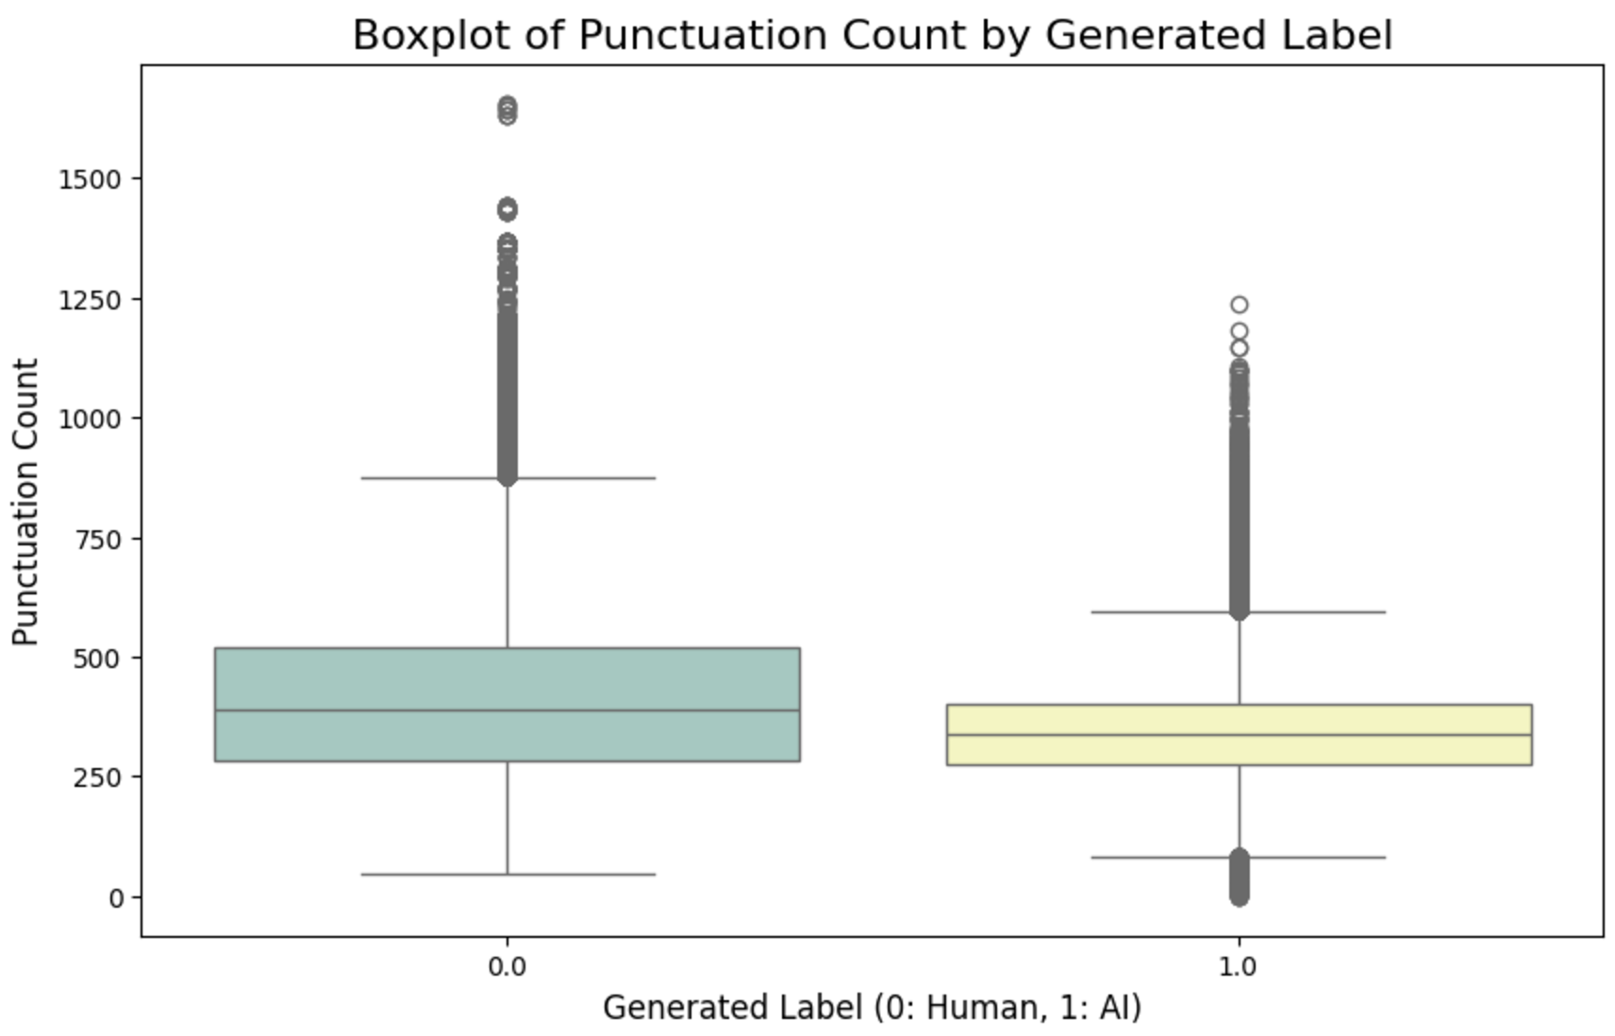
AI Vs Human Words Count

Slide 9
Logistic Regression Model
Model Overview: Simple and interpretable linear model.
Results:
Precision: 99%
Recall: 99%
F1-Score: 99%
Insights:
Logistic regression performs well on this dataset due to balanced classes and effective feature extraction.

Slide 10
Random Forest Model
Model Overview: Ensemble method for better accuracy.
Results:
Precision, recall, and F1-Score: 100% across all metrics.
Insights:
Random Forest's ability to handle non-linear relationships and complex data structures.
Importance of hyperparameter tuning.

Slide 11
Model Comparison
Logistic Regression vs. Random Forest:
Accuracy: Both models achieved near-perfect results.
Interpretability: Logistic regression is easier to interpret, while Random Forest may capture more complex patterns.
Why Both Models Worked Well:
Effective preprocessing.
Balanced dataset.
Quality of feature engineering.

Slide 12
Python Programming Insights
Libraries Used:
Pandas, NLTK, Scikit-Learn, and Matplotlib.
Challenges Encountered:
Handling large datasets.
Choosing the right vectorization technique.
Code Efficiency Tips:
Optimizing data preprocessing pipelines.

Slide 13
Machine Learning Insights
Data Preprocessing is crucial:
Tokenization, stopword removal, and lemmatization significantly impact results.
Feature Engineering Matters:
Simple text statistics (e.g., sentence length) provide valuable insights.
Model Selection:
Start with simpler models; use complex ones as needed.
Evaluation Metrics:
Precision, recall, and F1-score provide a comprehensive performance view.

Slide 14
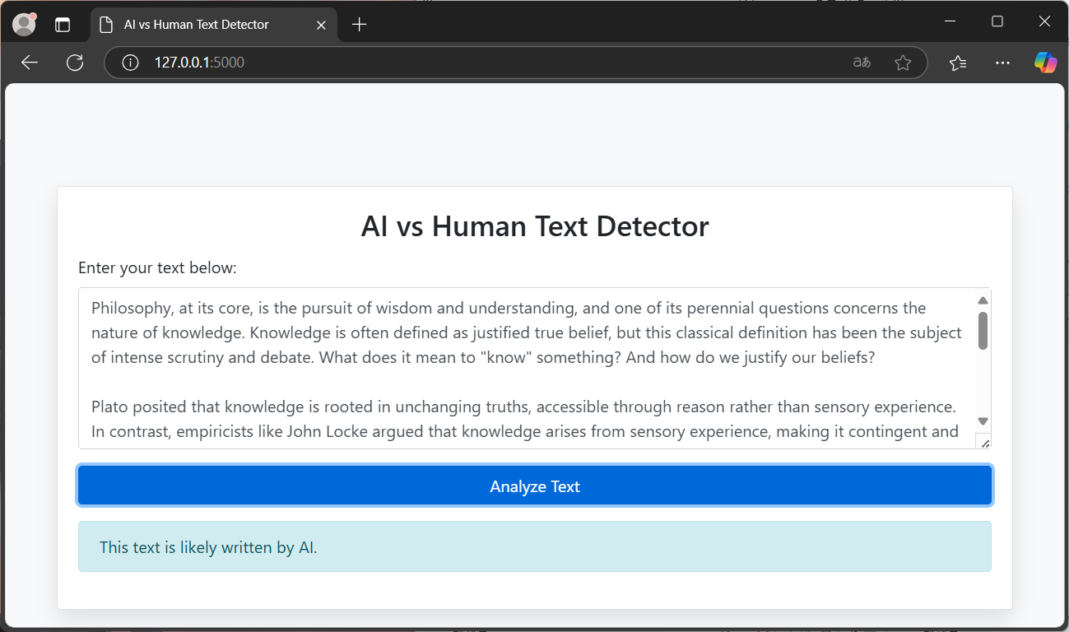
Web-based User Interface
① Access to webpage
② Write text to be analyzed
③ Click analyze button
④ Get result : Human or AI

Slide 15
Web UI implementation - Flask
Flask is a minimalistic web application framework
It is designed for fast and easy setup, while also offering the flexibility to scale up to more complex applications.
https://flask.palletsprojects.com/en/stable/
$ pip install flask

Slide 16
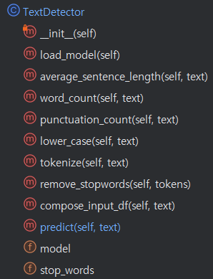
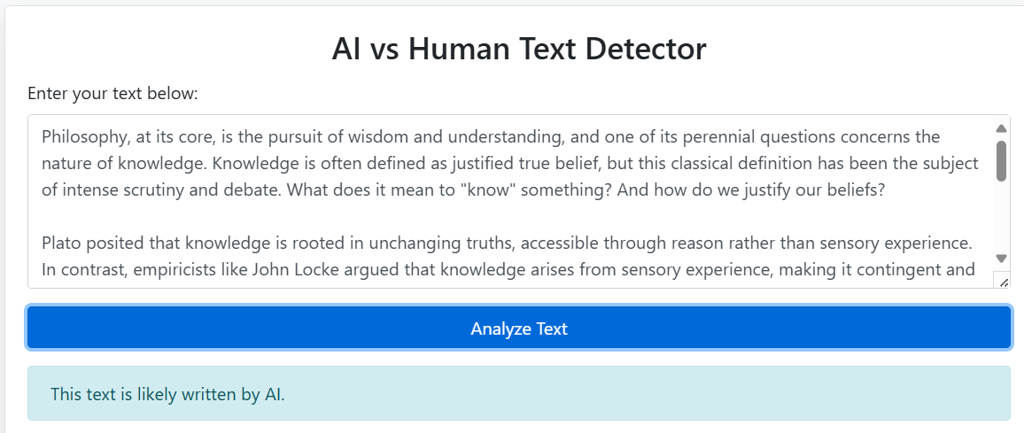
Code Structure
app.py
TextDetector.py
@app.route(‘/’)
def index():
rendering index.html
@app.route(‘/predict’)
def predict():
detector.predict(input_text)
return result
Index.html
Textbox
Button
CSS
…

Slide 17
Thank you!

